Slide 1

My Linear Relationships Interactive Notebook
Name
Class
Term 3 Semester 2

Slide 2
Contents
Formula Page
Page
Date
Description
2
3

Slide 3
Tasks
24
7
30
Essential Question
Questions
Notes
Summary
12
13

Slide 4

24
7
30
Date
Finding the equation of a line
EQ – What is the equation if we only have two points?
The equation of a line has the form
$$y=mx+c$$
Gradient
y intercept
Gradient = rise so how do we find c?
run
13

Slide 5
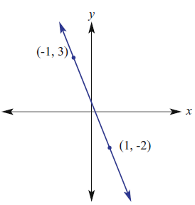
24
7
30
Date
Finding the equation of a line
EQ – What is the equation if we only have two points?
Point 1
ie height
Gradient = rise = (y₂ – y₁)
run (x₂ – x₁)
m = (-2 – 3) = -5
(1 + 1) 2
ie run
Point 2
13

Slide 6
24
7
30
Date
Finding the equation of a line
EQ – What is the equation if we only have two points?
Finding c
Use one of the points and the gradient to solve the equation.
y = mx + c m= -5/2 & pt (-1,3)
3 = (-5)(-1) + c
2
3 - 5 = c
2
c = ½
∴ y = -5x + 1
2 2
Point 1
Point 2
13

Slide 7
Questions Exercise 4.G Questions 3 - 7 Pages 232 - 233

Slide 8
Notes Review
24, 7 ,30
Date
Title
Essential question
Notes complete
Notes complete with colour and diagrams
Questions completed
Contents page filed in
Formula page filled in

Slide 9
Homework
Review your notes and write a summary answering the essential question.

